Slide 1

Automated Testing on Jeevee.com
Using Selenium
Presented by: Suyasha Nepal
12/04/2025

Slide 2

Introduction
Jeevee is an e-commerce platform with multiple user workflows.
Key workflows include login, product search and cart management.
Ensuring these workflows function correctly is essential for user satisfaction.
This project tests these workflows using Selenium and Python to validate functionality and reliability.

Slide 3
Problem Statement
  The multiple user workflows on Jeevee are prone to failure if not thoroughly validated.
  Frequent updates make it challenging to ensure all features work correctly.
  Increasing product complexity increases the risk of functional issues.
  Manual validation of all workflows become time-consuming and unreliable as platform expands.
  Comprehensive testing is needed to validate workflows and ensure a seamless user experience.

Slide 4
Objectives
01
02
03
Ensure all key workflows on Jeevee (login, search, cart) function correctly.
Detect functional issues and validate website behavior across different scenarios.
Improve reliability and maintain a seamless user experience for end-users.

Slide 5



















Tools and Technologies Used
PyCharm IDE
Python
Selenium
PyTest
GitHub
Copilot

Slide 6
Implementation Plan
Setup and Configuration
Test Data Preparation
Page Object Model (POM) Design
Test Script Development
Test Execution
Result Reporting and Validation Generate

Slide 7
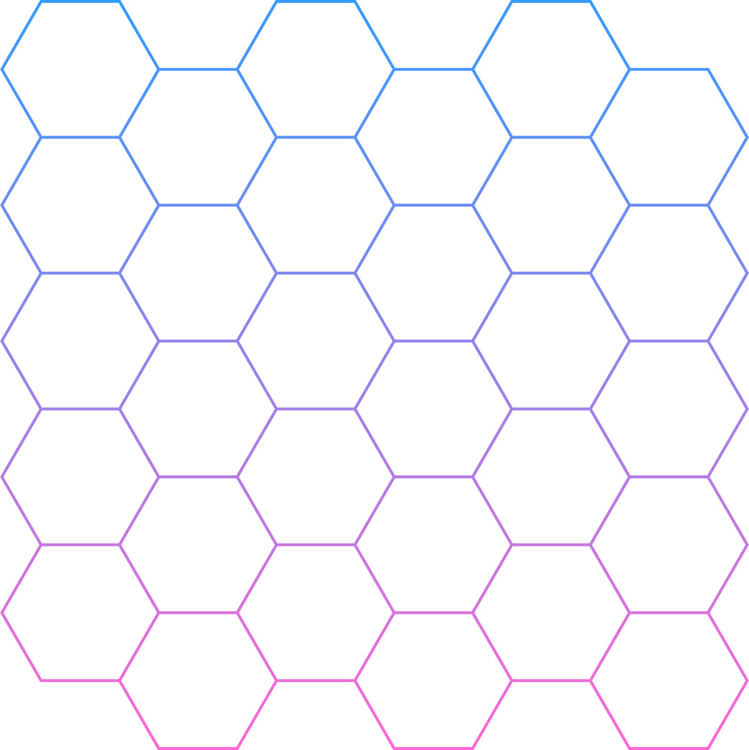
Design and Development
Used Page Object Model (POM) for modular page structure
Created BaseTest for driver setup, teardown and helper methods
Managed test data via JSON for flexibility
Developed modular PyTest scripts for clarity and reusability
Implemented robust action methods (click, type, scroll, wait)
Supported full E2E flow and individual scenario tests

Slide 8
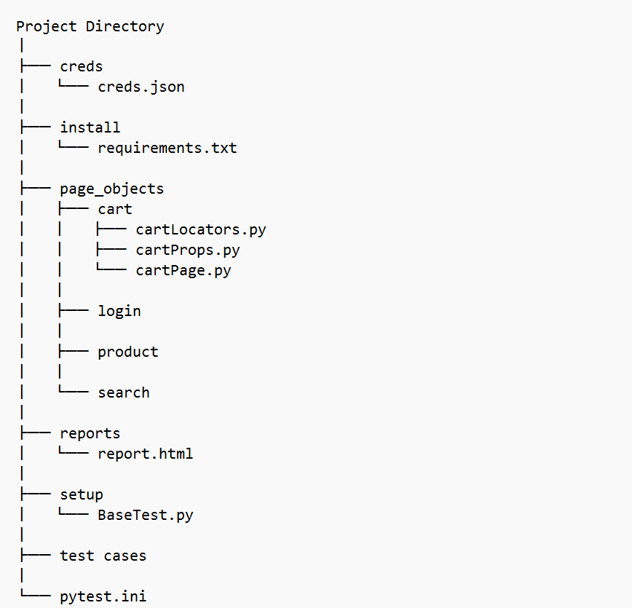

Folder Structure

Slide 9
End-to-End Flow
Launch Browser
Navigate to jeevee.com
Login Using Valid User Credentials
Search for a Target Product
Select the Product
Open the Product Page
Add Item to the Cart
Navigate to the Cart
Increase Item Quantity
Decrease Item Quantity
Remove from Cart
Proceed to Checkout

Slide 10
Additional Test Cases
Search and Add to Cart without Login
Multiple Login Tests using Parametrization
Login with Invalid Credentials
Search with Invalid Terms
Select First Suggestion from Search
Select Relevant Suggestion from Search

Slide 11

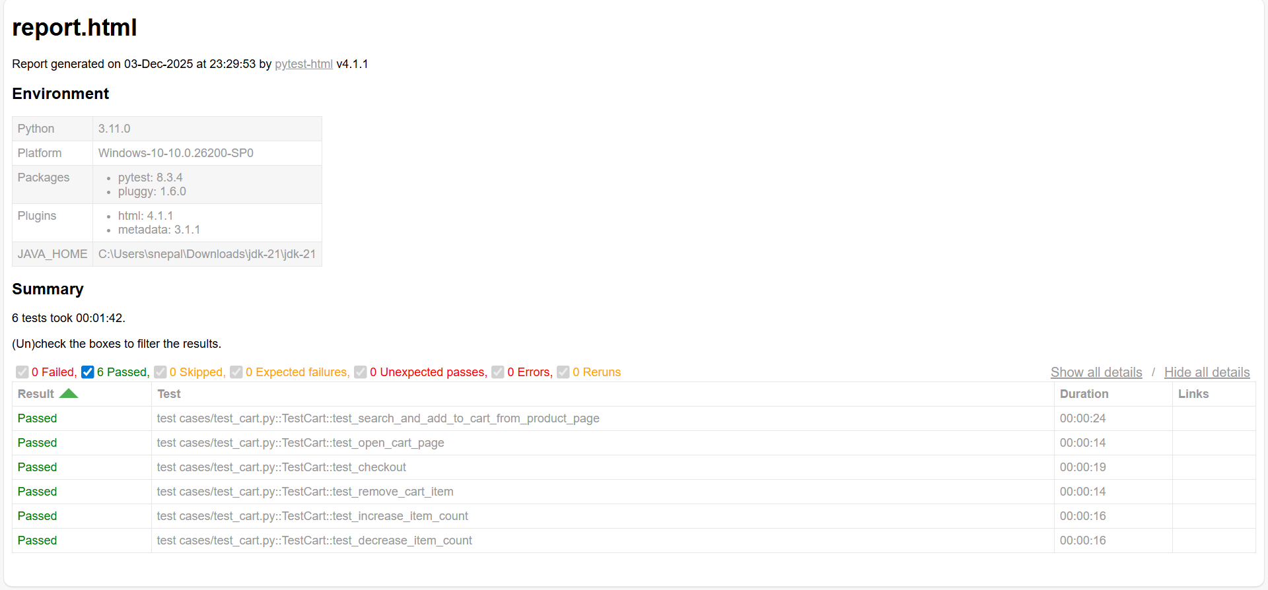
Test Execution Report

Slide 12
Challenges Faced
  Handling dynamic elements and overlays
  Scrolling to hidden elements
  Synchronization of cart actions
  Managing test data efficiently
  Flaky elements causing intermittent failures

Slide 13
Learning and Improvements
Learning
Improvements
Understanding E2E workflows and cart actions effectively
Managing test data with JSON for flexibility
Handling dynamic elements and overlays
Structuring tests using Page Object Model (POM)
Dealing with page complexity and variations in search
Instead of using find_element in every test, iterate through the entire list
Can add a function to add products directly from the home feed
Modularized and reusable code for better maintenance
Can add a reliable method to move the mouse away or dismiss hover menus during tests.

Slide 14
Conclusion
Implemented QA testing for Jeevee.com using Selenium and Python
Verified key workflows
Built modular tests with POM and JSON test data
Handled dynamic elements, overlays, scrolling, and synchronization
Improved reliability, coverage, and flexibility

Slide 15
Thank You!

